Slide 1

Lecture 12
-NLP is all about words, their arrangement and their meaning
-NLP is a branch of AI that tries to emulate/understand the way a human speaks to another human
-Lecture 12 is about relationships between words, the WordNet lexicon
[Ch. 19.0 to 19.3 of Jurafsky Martin]

Slide 2
What is a lexicon and how to use it
A lexicon like WordNet is a huge online dictionary containing words and their meanings
How to use?
Convert each word (called wordform) → its lemma
Each lemma has an entry in the lexicon
eg. celebrations→celebration sang→sing
In case of multiple senses, the meanings are differentiated by subscripts
Eg. bank₁ : “….meaning 1…..”
bank₂ : “….meaning 2…..”

Slide 3
Words and their inter-relationships
Word Sense = Word Meaning
Synonym: words with similar senses (eg. large, big)
Antonym: words with opposite senses (eg. big, small)
Homonym: words with same spelling but different senses (eg. lead)
Homophone: same pronunciation but different senses (eg. led, lead)

Slide 4
NLP terms associated with online lexicons………….
Hyponym (smaller group is hyponym of larger group)
Hypernym (larger group is hypernym of smaller group)
Meronym: “part of” (part-whole relation)
Eg. wheel is meronym of car
Opposite of Meronym: Holonym
Eg. Car is holonym of wheel

Slide 5
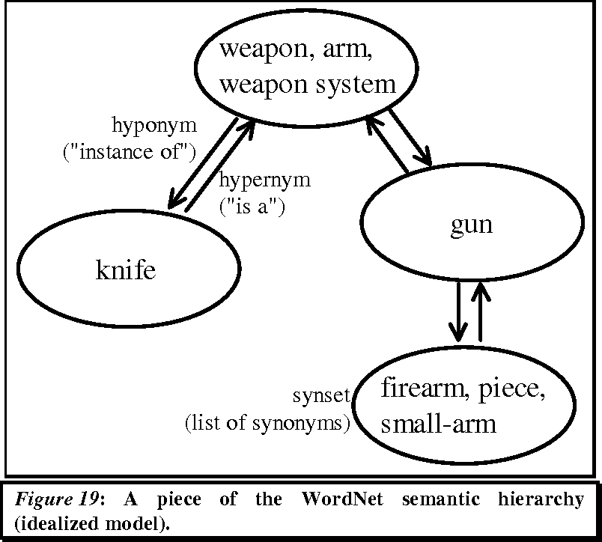
WordNet – the graphical relationship
https://www.semanticscholar.org/paper/Feature-Engineering-for-a-Symbolic-Approach-to-Text-Scott/4868907526fa5e03f3e398bbc4bd02dc937a9c43/figure/30

Slide 6
WordNet – the huge online lexicon
Word→lemma→synsets in Wordnet
1 synset: 1 sense of the word (‘gloss=definition’ is given for each synset)
Inside each synset: group of synonyms
Synsets connected with hyponyms and hypernyms
(Please go through both papers on WORDNET uploaded in MOODLE)

